Slide 2
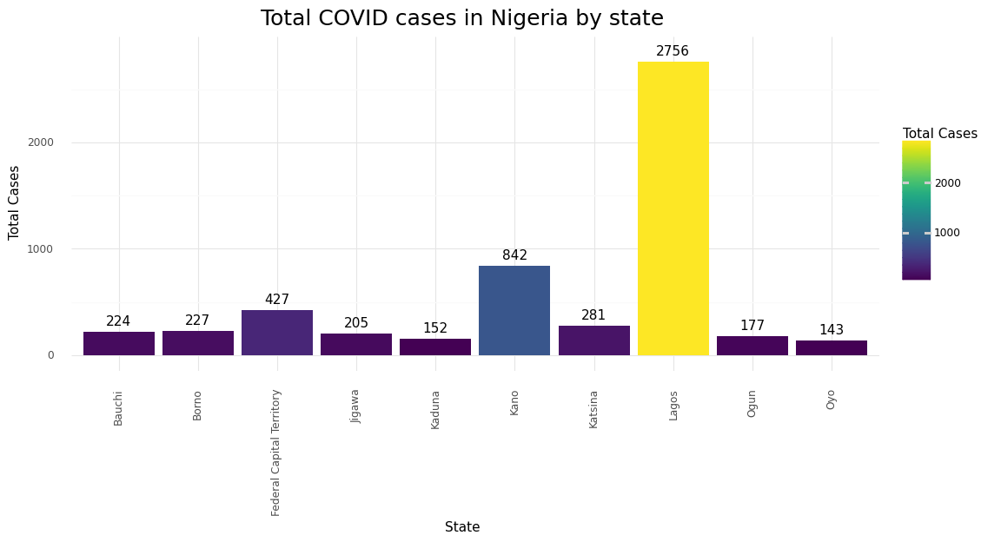
Cases by State

Slide 3
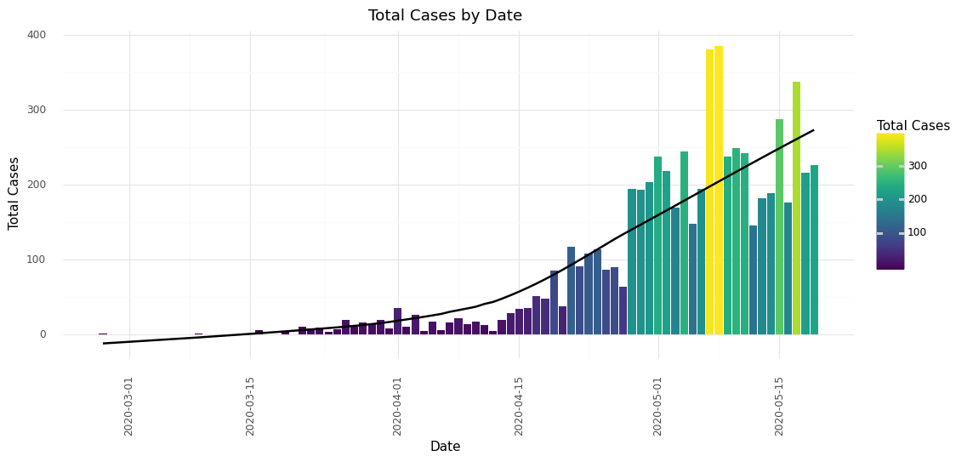
Cases by Date

Slide 4
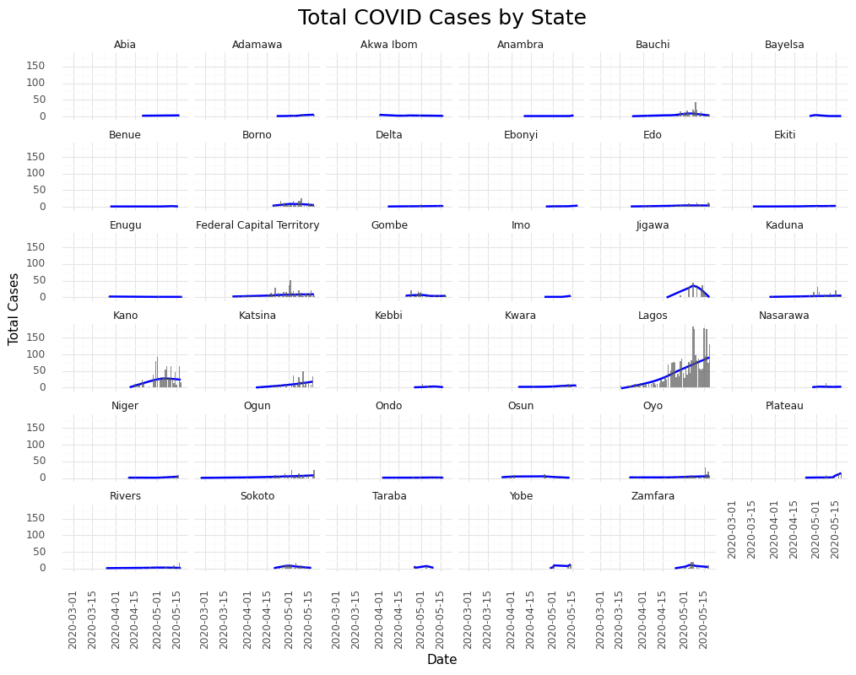
State cases by date

Slide 5
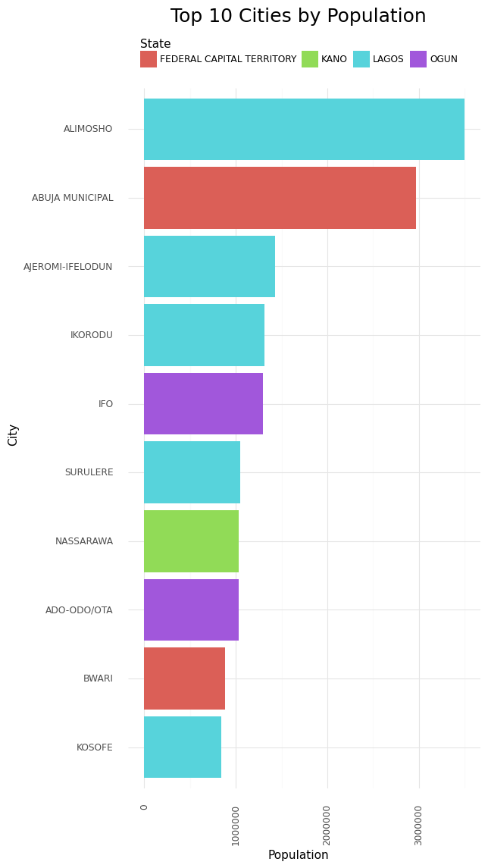
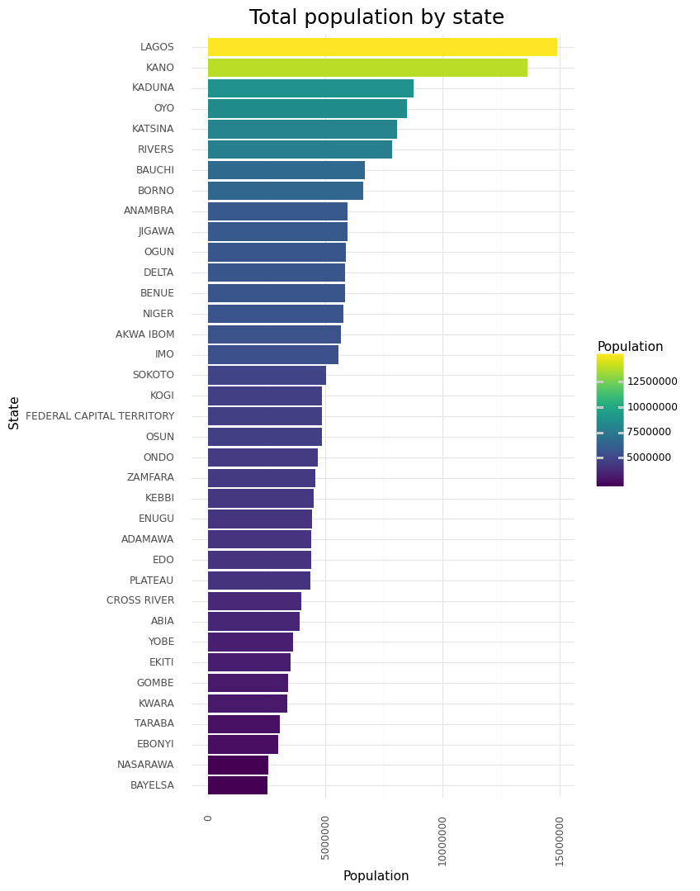

Slide 6
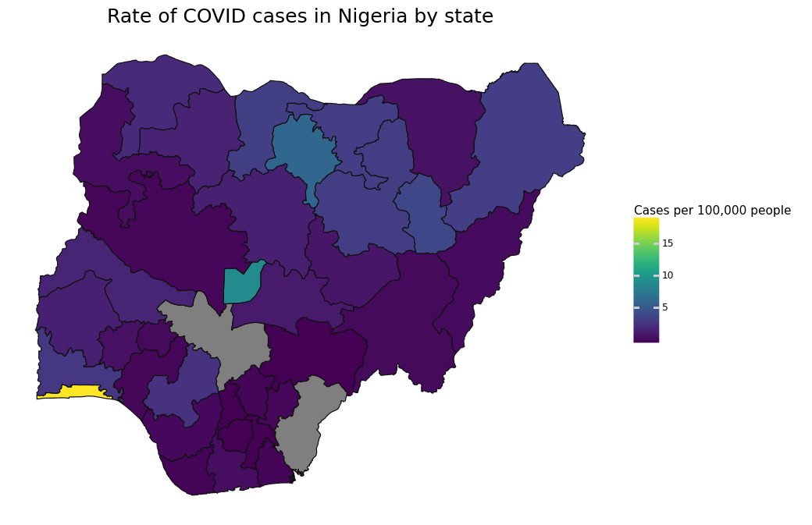
Lagos
Top state by COVID cases
Population: 7.3%
COVID Cases: 43.1%
_{as % of national totals} 18.5 cases per 100,000 people
Lagos, Kano &
Federal Capital Territory
Top 3 states by COVID cases
Population: 16.3%
COVID Cases: 62.9%
_{as % of national totals} 12.1 cases per 100,000 people
All states:
3.1 cases per 100,000 people

Slide 7
Tracking spread of COVID

Slide 8
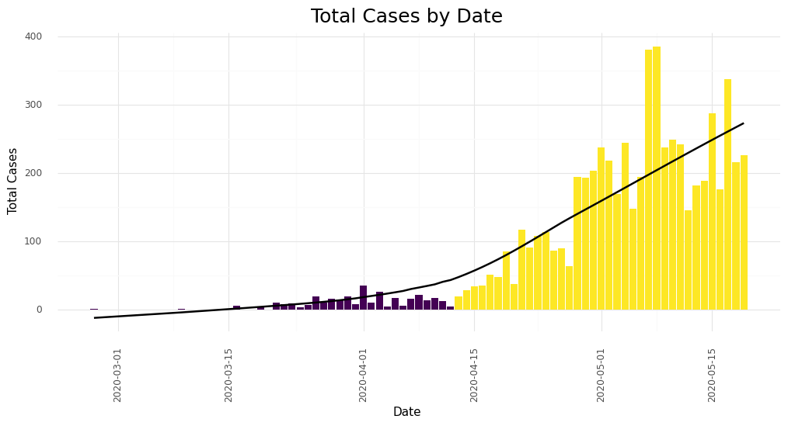
Initial waves

Slide 9
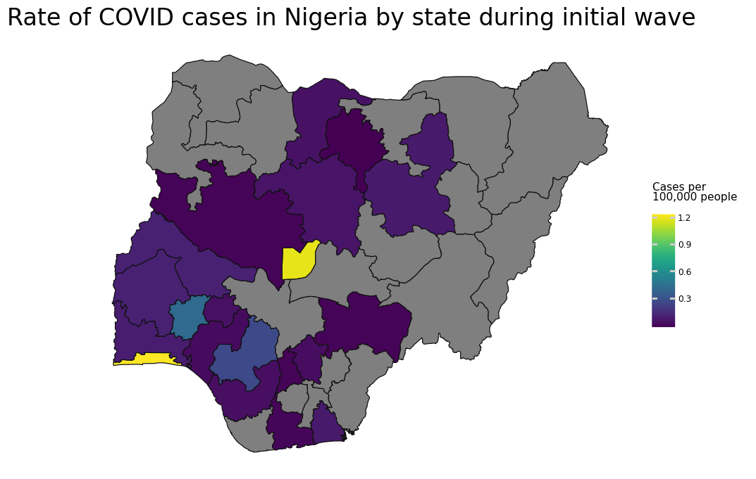
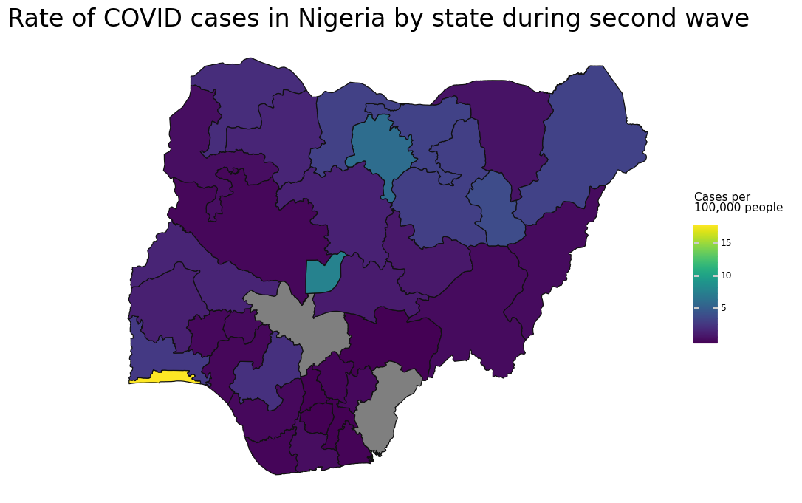
Wave 1 vs. Wave 2

Slide 10
